Slide 1
Documentation of The Annual Living Inclusion Forum Inclusion in the Fields of Crisis, Education, Employment
5 June 2024, 2.00-3.30 pm CET

Slide 2
Topics
Inclusion in Times of Crises
Inclusive Employment Programming and TVET
Education 4 All

Slide 3
Agenda
Welcoming and network update
Concept/Introduction of Session 1
1st Round of Networking Sessions
Introduction of Session 2
2nd Round of Networking Sessions
Summary & Outlook
Closing

Slide 4
Getting to know the Network
Rebecca Daniel, GIZ

Slide 5
The Network
231 Members as of December 2023
557 Members as of June 2024 (GIZ, Governmental and Multilateral Organisation, NPOs, OPDs, Academia…)
+100 since our last Event
50 Countries
Learn more about the network:
Sign up for the network!
Access the network´s newsroom

Slide 6
Concept and Introduction of Session 1
Moritz Ksoll, GIZ

Slide 7
Basic Concept
We will have two Sessions
Each sessions consists of three Rooms with Speakers on Crisis, Education and Employment
There will be an Input by the Speaker (approx. 10 minutes), followed by a Q&A-Session (approx. 20 minutes)
After the first Session you will be redirected to the main Room

Slide 8
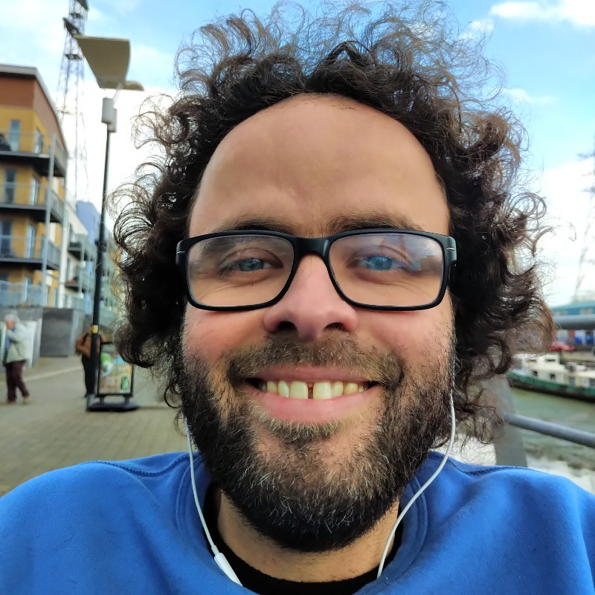
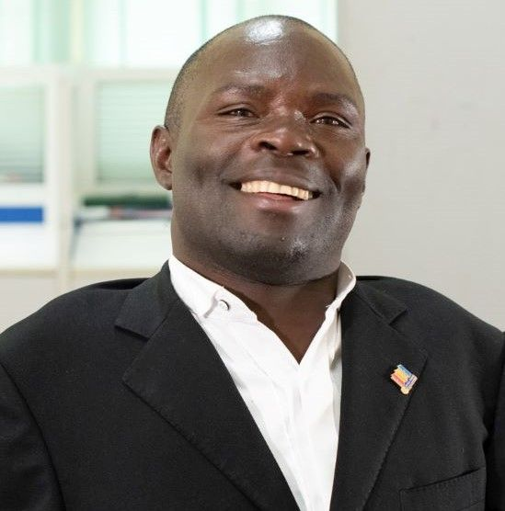
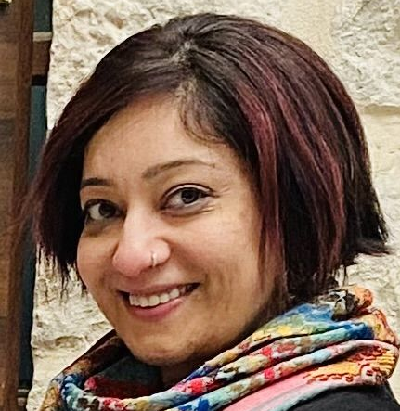
Session 1- Introduction of Speakers
Peter Torres Fremlin, Disability Debrief
Ronald Kasule, DASUNS/UNFPA
Kalpana Kumar, GIZ Jordan

Slide 9
Peter Torres Fremlin
Intersecting Crises through the Lens of Disability
Author of Disability Debrief, a newsletter putting a lens on international disability news and curating information from 150 countries
A career of advising international organisations on disability inclusion with a focus on employment
Focus topics: How disability relates with the dynamics transforming our world
Sign Language Interpretation

Slide 10
Ronald Kasule
DASUNS: Advancing Rights, Choices & Opportunities for Persons with Disabilities through Assistive Technology
Founding CEO of DASUNS (Diversity Ability Support Network System)
Disability Inclusion Specialist at the United Nation Population Fund (UNFPA) in Kampala, Uganda
Focus Topics: Inclusive Employment and Vocational Training; Disability Rights and Inclusive Programming
Closed Captioning

Slide 11
Kalpana Kumar
Reflections from implementing the Promoting quality in inclusive education in Jordan (PROMISE) project
Advisor at GIZ´s Promoting Quality of Inclusive Education in Jordan (PROMISE) project and Co-Speaker of GIZ’s Global Network for Education and Youth (GNEY)
15 years experience in more than 8 countries in designing and implementing inclusive education programmes of various development cooperation agencies
Focus Topics: Disability Inclusive Early Childhood Education and Basic Education, Inclusive Education Policy, Research, Disability Data, School Improvement, Teacher Capacity Development
Graphic Recording

Slide 12
Presentations Session 1
In the following, please find the slides used by our speakers in their respective break-out sessions for your review:

Slide 13
Peter Torres Fremlin:
Intersecting Crises through the Lens of Disability
Peter did not use any slides for his input.
Instead, please find a summary of his main talking points in the following:

Slide 14
Democratic transformation
This year: Huge fraction of population going to the polls
Does not mean democracy is meaningfully performed
Further Reading:
Disabled people in Peru's political crisis: https://www.disabilitydebrief.org/debrief/peru-political-protests/

Slide 15
Economic side
International organisations have not looked enough at living with disability during time of austerity measures
How do we support people in that pinch?
Further Reading:
Some notes on economic crisis: https://www.disabilitydebrief.org/debrief/feeling-pride-feeling-poorly-feeling/#sinking-in-economic-crisis

Slide 16
Conflicts
Including: Civil war in Sudan, war in Ukraine, conflict in Israel and Palestine
Disabled people as combatants & victims are disproportionately affected
New disabilities being created
Further Reading:
Reporting on disability and conflict:
https://www.disabilitydebrief.org/tag/conflict/
Disability in Israel-Palestine conflict: https://www.disabilitydebrief.org/library/topic-israel-palestine/

Slide 17
Climate Change
Important focus
How are people with disabilities bound up in this?
Further Reading:
Disability and climate change:
https://www.disabilitydebrief.org/climate/

Slide 18
Challenges
How to conceptualize and push back against society’s presumptions?
Important to also work with other movements outside of the disability inclusion box

Slide 19
Ronald Kasule:
DASUNS: Advancing Rights, Choices & Opportunities for Persons with Disabilities through Assistive Technology
Please find Ronald‘s slides in the following:

Slide 20
Inclusive Employment & TVET
Ronald Kasule, CEO - Dasuns
Annual Living Inclusion Network FORUM
June 5th, 2024

Slide 21
Personal Journey
Person with lived experience of disability
Struggled accessing educ- & the job market
Persevered through school despite considering vocational training

Slide 22
Initial Challenges
Struggled to find employment despite excellent academic grades
Decision to mobilize colleagues & start a non-profit organization to address social issues & create employment opportunities

Slide 23
Professional Fellows Program
Participated in the PFP on Disability Inclusive Employment with support from the US State Dept.
Focused on learning from the American experience & adapting lessons to the Ugandan context

Slide 24
Business Case for PWDs Employment
For the out-bound project, Initial efforts focused on supporting private sector to appreciate the "Business Case of employing PWDs“
Key lesson: Private sector willingness but face challenges with inadequate access to care support services.

Slide 25
Validation through IDA Global Survey Findings
2020 IDA Global Survey highlighted that OPDs reported members lacked access to necessary care support services.
Emphasized the need for care support services for effective participation of OPDs in development policies and programs.

Slide 26
Founding of Dasuns
Established Dasuns to eliminate access barriers to care support services through AT.
Diversity Ability Support Network System
Advancing Rights, Choices & Opportunities for person with disability through Assistive Technology

Slide 27
A Web & Mobile phone based application connecting PWDs & partners to people trained or have experience in providing care support services

Slide 28
We also:
Provide refresher Trainings to care support providers
Research and Innovation in Assistive Technology
Strengthening Capacity of partners on Inclusive Programming
Mentor Youth with Disabilities in ICTs

Slide 29
Conclusion
Welcome for Partnership & Collaboration for increased Impact
Q&A

Slide 30
Contact Details
E-mail | dasuns.org@gmail.com
Skype | ronald.kasulem
Facebook | https://www.facebook.com/dasunsorg
Linkedin | https://www.linkedin.com/company/dasuns
Website | https://dasuns.org/
Twitter | https://twitter.com/dasuns5

Slide 31
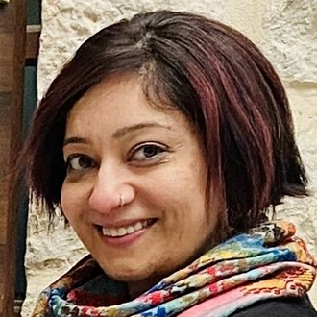
Kalpana Kumar:
Reflections from implementing the Promoting quality in inclusive education in Jordan (PROMISE) project
Please find Kalpana‘s slides in the following:

Slide 32
Presented by: Kalpana Kumar
Reflections from implementing the Promoting quality of inclusive education in Jordan (PROMISE) project

Slide 33
Promoting Quality in Inclusive Education in Jordan at a glance
Objective: The pedagogical, organizational and institutional preconditions with regards to the implementation of inclusive, gender-sensitive education have improved especially at school
level.
Irbid
Ajloun
06/2018 - 05/2026 ( implemented in 2 phases)
25 Mio. EUR
Amman
Commissioned by
Karak
Al Tafileh
Jordanian Ministry of Education as the political partner
Children in public schools (pre-school to grade 10) in Jordan, particularly at 60 pilot schools in 6 field directorates (approx. 54,000 children reached directly).
Aqaba
1.3 M Syrian Refugees, Palestinian refugees, population doubled in last 20 years

Slide 34
Key fact!
Basic education will no longer be supported by BMZ in bilateral projects
Contradiction between wholistic approach to disability inclusion and not supporting basic education????

Slide 35
Focus of this Presentation
What works? (to remove barriers to inclusive education?)
Brief overview of the barriers to inclusive education
To unpack one or two key barriers
Understand similarities/differences in barriers in other countries/projects

Slide 36
Barriers to inclusive education
Early detection and early intervention
Data!
Policy
Prejudice and stigma
Teacher capacity
Infrastructure

Slide 37
Policy barriers
Gap between policy rhetoric and actual implementation
Lack of awareness about policy
Limited understanding at all levels regarding rights-based approach
Strong political will and commitment

Slide 38
Data
Lack of robust data of persons with disabilities
Lack of unified methodologies to data collection (E.g. Washington Group approach)
No tracking system for dropouts
EMIS collects disability data
Notes:
Pandora’s box!

Slide 39
Early detection and early intervention
Lack of awareness of importance of and availability of early detection and early intervention services
Not enough services
Location of services, transportation costs
No strong collaboration between different ministries
Vision and Hearing Screening
Notes:
Pandora’s box!

Slide 40
Teacher capacity
Teachers’ limited knowledge and skills in inclusive pedagogy
Deficits-based approach towards children with disabilities
Other pressures of teaching in low-resourced schools
(E.g. Crowded classrooms)
Teachers’ willingness is key!
Notes:
Pandora’s box!

Slide 41
Attitudinal barriers: Prejudice and bias
Multiple vulnerabilities due to prejudices and bias (E.g. Refugee children with disabilities)
Lack of acceptance or denial by families
‘Child is the problem approach’ in school
Inclusive school culture = acceptance
Notes:
Pandora’s box!

Slide 42
Infrastructure barriers
Lack of accessible classrooms and toilets
Lack of teaching-learning materials
School Construction Guidelines endorsed
Notes:
Pandora’s box!

Slide 43
Food for thought
What are the top 3 barriers to inclusive education in your countries?
Similarities/differences to Jordan?
What solutions have you tried to address these barriers?
What has worked successfully

Slide 44
THANK You!

Slide 45
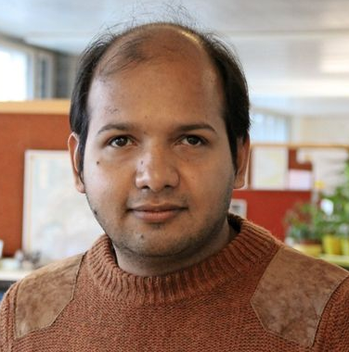
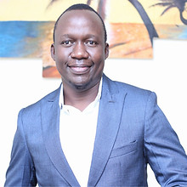
Session 2 - Introduction of Speakers
Talal Waheed,
CBM
Maxwel Ajuoga, Kilimanjaro Blind Trust Africa
Sumita Kunashakaran, Inclusive Creation

Slide 46
Talal Waheed
Early Action saves Lives: Towards inclusive early Warning Systems in Cameroon and Niger
Disability-inclusive Humanitarian Expert and currently Global Advisor on DIDRR (Disability Inclusive Disaster Risk Reduction) at CBM
Over 15 years experience working with international NGOs, United nations agencies, Governments, and humanitarian clusters on Disability inclusion across Africa, Asia, Europe, and Americas during natural and human induced emergencies.
Focus Topics: Disaster Risk Reduction, Humanitarian Programming, Intersecting Crises
Sign Language Interpretation

Slide 47
Maxwel Ajuoga
Access to Quality Education as a Pathway to meaningful Inclusive Employment
Programs Manager at Kilimanjaro Blind Trust Africa
leads initiatives to empower children and youth with visual impairments across Sub Saharan Africa
Focus Topics: Inclusive Education, Inclusive Employment
Closed Captioning

Slide 48
Sumita Kunashakaran
Education 4All: A Class Act – Breaking Barriers, Building Futures.
Chief Inclusion Officer and independent Consultant
Working Experience with ILO, GIZ, ATOS, Zero Project and many more
Focus Topics: Inclusive Leadership, Self-Advocacy, Rights of Persons with Disabilities, Inclusive Education
Graphic Recording

Slide 49
Presentations Session 2
In the following, please find the slides used by our speakers in their respective break-out sessions:

Slide 50
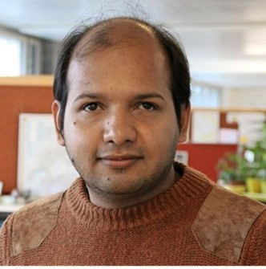
Talal Waheed:
Early Action saves Lives: Towards inclusive early Warning Systems in Cameroon and Niger
Please find Talal‘s slides in the following:

Slide 51
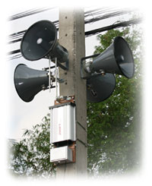
Early action saves lives: towards inclusive early warning systems in Cameroon and Niger
By Talal Waheed (Global Advisor Disability Inclusive DRR)

Slide 52
Context
Niger and Cameroon’s Sudano-Sahelian agro-ecological zone (in the Far North Region) are extremely vulnerable to climate hazards – heat waves, floods and droughts.
Person with Disability are the most vulnerable in disasters due to impairment and Information on disaster preparedness is often not accessible to them.

Slide 53
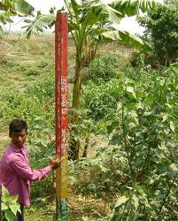
Key objective
To facilitate the design of multi-hazard early warning systems that engage persons with disabilities and communities at risk of drought and floods on an equal level.
Stakeholders
DRM/Early warning management agencies
CBM/partners
Persons with disabilities/OPDs

Slide 54
Key Findings
Existing early warning/communication systems
Cameroon : National Emergency Response Centre in place which aims to facilitate the flow of information in times of crisis, a National Contingency Plan -
Niger : Disaster risk reduction (DRR) strategy that includes a component of EWS but not inclusive; Cell of EWS , flood contingency plan
Inclusion in early warning and DRM processes
Persons with disabilities were not involved in the design of early warning systems, needs of person with disabilities are not in current EWS
Disability disaggregated data was not available for DRM Organisations
Accessibility of information
Information was not in an accessible format to be useful for people
with different types of disabilities

Slide 55
Available tools/technology
Means of communication are available and access to various social media platforms, with WhatsApp and email being predominant.
Television and radio also have a big coverage, which are being used for early warning communication
Major barriers to inclusion in EWS
lack of disaggregated data
lack of participation of persons with disabilities in disaster management processes
lack of knowledge of inclusive tools or channels of communication
inadequate policy in the countries to consider the specific needs of persons with disabilities.
people with disabilities or their organisations were not
adequately engaged at community levels

Slide 56
Expectations of the stakeholders
Localised early warnings in communities, social media, or additional modes of communication to be adaptive to accessibility related needs.
Updated and reliable information on timing, date, and location of upcoming hazards.
Support the participation and the empowerment of persons with disabilities in early warning actions.

Slide 57
Recommendations
From the recommendations , a Multi-hazard disability-inclusive Early warning system programs for Cameroon and Niger must :
Ensure stakeholder engagement
Gather disability disaggregated data
Inclusive needs-based early warnings
Pilot an inclusive early warning system
Inclusive risk assessment
Accessible monitoring and predicting systems
Ensure information communication systems

Slide 58
Read new study by CBM
Early action saves lives: towards inclusive early warning systems in Cameroon and Niger in either French or English.

Slide 59
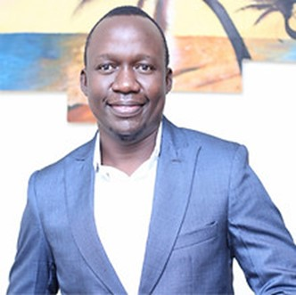
Maxwel Ajuoga:
Access to Quality Education as a Pathway to meaningful Inclusive Employment
Please find Maxwel‘s slides in the following:

Slide 60
Access to quality education as a pathway to meaningful inclusive employment

Slide 61
Who’s KBTA
Works in the innovation and technology space to promote access to quality inclusive education and employment opportunities for learners and the youth with visual impairments in Sub Saharan Africa. Our work is anchored 4 strategic pillars:
Access to digital literacy skills
Promote access to STEM subjects
Job skilling and employability skills
Research & innovation on development of assistive technologies

Slide 62
Evidence
An estimated 1.3 billion people – or 16% of the global population – experience a significant disability today according to WHO report. Majority of this percentage comes from the global south.
This presents a huge market for Edtech innovators and entrepreneurs to develop contextualized ATs. There is need to rapidly shift from the charity models in AT provision to business models to create sustainable pathways.
Evidence proves that education plays a critical role in cultivating the abilities of individuals within society. The right to education is fundamentally guaranteed to all individuals, sighted or visually impaired.

Slide 63
Assistive Tech as an Enabler by Unlocking the existing Barriers to Educational Access
Limited access to affordable digital Braille assistive technologies in Sub-Saharan Africa that limits VI learners’ access to quality education. There is a huge potential for contextualized innovation and research on AT.
Provision of Assistive Technologies user, repair and maintenance training to the CWDs and teachers is essential to ensuring sustainability.
The desire to improve on educational outcomes of VI learners not only comes through access ATs, but also making curriculum and supplementary learning materials accessible.
Incorporating assistive technology training in the pedagogy for teachers .

Slide 64
Transitions in Education and its Impact on Employment
Education by all means presents the foundation upon which employment is driven.
When CWDs are unable to access quality education, there learning outcomes are negatively impacted leading to low transitions from one level of education to the other.
Low transitions in learning implies that only few YWDs are exposed to the competitive labor market.
Low quality education means that YWDs in the labor market lack competitive skills.

Slide 65
Our role in promoting employment for PWDs
Working with employers and persons with disabilities to co-create job specific readiness skills is essential in ensuring more PWDs are getting into the labor market.
There is a need to shift from the traditional conventional advocacy practices to a more inclusive and employee/employer centered advocacy strategies to accelerate workplace disability inclusion.
Formal or informal employment? Or both?
When employment for PWDs is discussed, there is been deliberate narrative to focus on informal employment. But we must endeavor to create an environment where PWDs can thrive in both formal and informal employment like anyone else.

Slide 66
Key Question
Can we leverage on education as a pathway to employment for all?
Thank you!

Slide 67
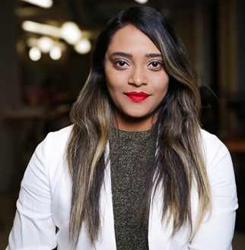
Sumita Kunashakaran:
Education 4All: A Class Act – Breaking Barriers, Building Futures
Please find Sumita‘s slides in the following:

Slide 68
Education4All: A Class Act Breaking Barriers, Building Futures!
Sumita Kunashakaran Chief Inclusion Officer Inclusive Creation AS sumita@inclusivecreation.com

Slide 69
Common Barriers to Inclusive Education
Lack of Training for Educators
Inadequate Resources
Physical Barriers
Attitudinal Barriers
Rigid Curriculum
Insufficient Policy Support
Social Barriers
Language & Cultural Barriers
Financial Constraints

Slide 70
Inclusive Educational Policies
Individualised Education Plans (IEPs): Tailoring education plans to meet the specific needs of each student.
Universal Design for Learning (UDL): Designing curriculums that accommodate all learners from the outset.
Flexible Assessment Methods: Using diverse assessment strategies to accurately measure student progress and abilities.
Inclusive Teaching Strategies: Implementing differentiated instruction and cooperative learning to engage all students.

Slide 71
Successful Policies
Notable Legislations
Finland: Known for its robust support system, Finland emphasises teacher training, small class sizes, and early intervention.
Italy: Italy's "Inclusion Law" integrates students with disabilities into mainstream classrooms with the support of specialised educators.
Canada: Inclusive education is a provincial responsibility, with strong policies in Ontario and British Columbia supporting diverse learning needs.
Australia: The Disability Standards for Education 2005 ensure that students with disabilities can access and participate in education on the same basis as other students.
India: Right to Education Act (RTE)
South Africa: The White Paper 6 on Inclusive Education
Brazil: The National Policy on Special Education in the Perspective of Inclusive Education
United States: Individuals with Disabilities Education Act (IDEA).
Sweden: Education Act which includes provisions for students with special needs.
Japan: Fundamental Law of Education promotes inclusive education and equal opportunities.

Slide 72
Let’s Network!
Group 1: Identifying Barriers and Solutions
What are some common barriers to education you’ve observed?
What innovative solutions have you seen to overcome these barriers?
Group 2: Tailored Resources and Culturally Sensitive Curriculums
How does your curriculum incorporate cultural sensitivity and diversity?
What are the benefits and challenges of implementing a diverse curriculum?
Group 3: Community and Parental Involvement
How do you engage parents and the community in the educational process?
How can we improve community and parental involvement in education?

Slide 73
Sumita Kunashakaran Chief Inclusion Officer Inclusive Creation AS sumita@inclusivecreation.com

Slide 74
www.sumitakunashakaran.com

Slide 75
Outlook
How can you get involved?
Rebecca Daniel, GIZ

Slide 76
Your input is needed!
Let us know what you think!
Contribute to the newsletter & the events!
Spread the news!
Register for the Living Inclusion Network on our website!

Slide 77
Upcoming network activities
Members only
Inclusion Café (autumn 2024)
Newsletter (next week)
Public
Activity on 3rd Dec

Slide 78
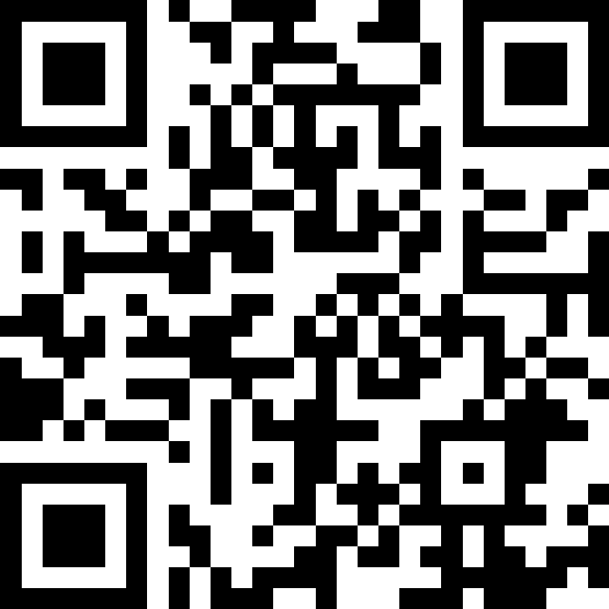
Event Evaluation
Please click here for the final event evaluation

Slide 79
What our Speakers would like to share
Disability Debrief is an engaging guide, for the disability community and disability curious. It sees world news through a disability lens.
A weekly newsletter combines lived experience, analysis, art and original reporting. And an online library curates resources from 145+ countries and regions.
Sign up for the Newsletter here
Notes:
Newsletter published by Peter looking at the world news with a focus on disability. Peter would like to invite you to have a look and if you like, sign up for the newsletter.

Slide 80
What our Speakers would like to share (2)
"The Sins and Wins" series by Sumita Kunashakaran offers practical strategies for inclusive leadership and design, turning promises into impactful practices.
You can find more information and purchase options on her website at www.sumitakunashakaran.com.
Notes:
Sumita has published a book series on practical inclusive leadership and design. You can check it out on her homepage.

Slide 81
What our Speakers would like to share (3)
What is the Global Network Education & Youth? GNEY is a forum for professional exchange and sectoral cooperation between experts in partner countries and Germany. It covers all aspects relating to education, youth and sports and links around 50 projects and programs in 35 countries and regions all over the world. In case your GIZ project wants to join the network, you can contact vera.nebelung@giz.de.
Event on Social and Emotional Learning (SEL) as integral part of Non-Formal Education (July 2024)
Challenge Fund Proposal on Inclusive Tech-Hackathon in 3rd Quartal 2024 (Winning Proposal to be implemented)
GNEY Conference in May or September 2025
Notes:
Kalpana wants to share another network with a thematic focus on education and youth. It follows a similar approach as our Living Inclusion Network, but is GIZ-internal. If you and your program are interested in joining, you can contact the mentioned mail address. Some events that they are planned for this year, are shown in the grey boxes.

Slide 82
What we would like to share (1)
Side Event: “Business driving a sustainable future: disability-inclusive employment and ESG” at the 17th conference of State Parties (COSP) to the United Nations Convention on the Right of Persons with Disabilities (CRPD) – 10/06/2024, 11:30am – 12:45pm (ET) co-sponsored by the United Nations Global Compact and the German Federal Ministry for Economic Cooperation and Development (BMZ) – will highlight latest good corporate practices as they relate to the employment of persons with disabilities in companies’ sustainability efforts, including as part of wider Environmental, Social, and Governance (ESG) strategies. Speakers will include representatives from Microsoft, Sanofi, Capgemini, Atos and the United Nations Global Compact. Interpretation into International Sign and live captioning will be provided
Join here

Slide 83
What we would like to share (2)
SAVE THE DATES!
Launch of Commitments mechanism during side event on COSP next week (NY and online)
The GDS co-hosts will announce how to submit proposals for side events and thematic workshops by early Autumn 2024.
African Pre-Summit: 4 September in Nairobi
Pre-Summit in Jordan: November in Amman
European Pre-Summit: 6th December in Berlin
Upcoming: Plans for Pre-Summits for Asia, North-America and Latin-America (between September 2024 and January 2025)
Civil Society Forum and Disability Data Forum: 1st April 2025 in Berlin
Global Disability Summit (GDS): 2nd-3rd April 2025 in Berlin

Slide 84
Thank you! Let‘s shape this network together. Together we are #LivingInclusion!
Register on our website
Follow us on X @GPInclusion
Or send us an email: disabilitynetwork@giz.de
Notes:
Visit our still website (The site is still new and will be increasingly expanded in the coming weeks.)
Follow our project on Twitter
Write us an email

